Slide 1
COVID-19’s Impact on College Students
By Cameron Diwa, Cleo You,
Madeline Maeloa, Sivakon Mahasandana
Notes:
Note section

Slide 2

Problem Statement
How has the pandemic impacted student learning and well-being?
How has online learning affected undergraduate college students’ well-being and mental health
How does their well-being and mental health impact their academic success?
Notes:
Cleo

Slide 3

Literature Review - Academic Success
The pandemic led to steep declines in enrollment at community colleges (Morona, 2020)
Have more non-academic obligations than traditional university students
Online learning exacerbated dropout rates, and therefore negatively impacted academic success at community colleges
Notes:
CAMERON

Slide 4
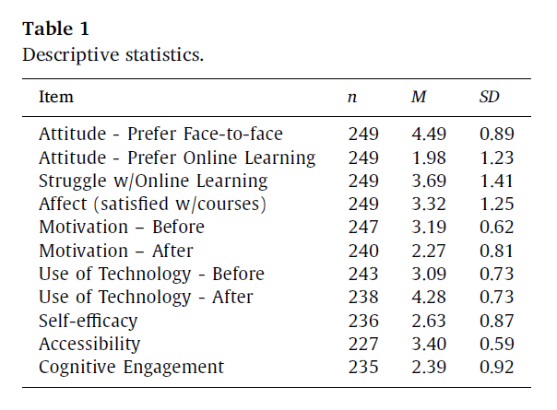
Literature Review - Academic Success (Students’ Preference)
Motivation Scale
1=not motivating
2=slightly motivating
3=motivating
4=very motivating
Aguilera-Hermida, A. P. (2020)
Notes:
Cleo: This is an article from Aguilera-Hermida in 2020.
students answered their preference and if they struggled with adapting to online learning via survey. Their preference implies a positive attitude towards their selection. Students showed a stronger preference for face-to-face learning than for online learning.
Next will be [Blue Boxes] Participants rated each on a four point scale, where you can see on your right. Participants motivated mean was 3.19 before the stay-at home due to pandemic. After the stay-at home, students motivation decreased. Responses showed acceptable internal consistency.

Slide 5
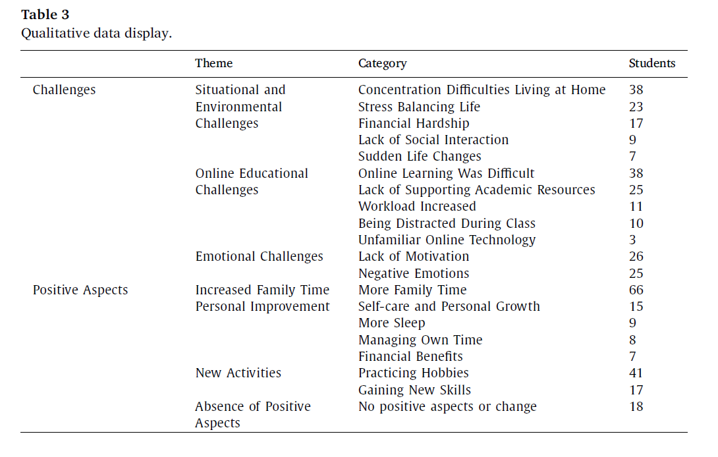
Literature Review -Academic Success (Students’ Environment)
Aguilera-Hermida, A. P. (2020)
Notes:
Cleo
This table shows the qualitative data with the themes, categories and the number of responses for the challenges and positive aspects mentioned by students. Participants’ environment shows students challenges and positive aspects related to literature review. Due to Covid-19, there are three themes emerged from challenges: Such as situational and environmental challenges, online educational challenges and emotional challenges. Students reported their biggest challenge to be concentrating while being at home. Online environment was difficult at the same time. These challenges causes their emotional challenges such as lack of motivation.
Three themes emerged related to positive aspects of changes that students experience after the stay at home order: increased family time, personal improvement, and new activities. Students reported more time with family and they are doing new activities such as practicing hobbies.

Slide 6
Literature Review - Mental Health and Well-Being
Abrupt shift to online learning forced students to distance themselves from their peers (Lederer et al., 2020)
Negatively impacted their sense of social connectedness and belonging
Led to increased feelings of isolation and depression
The pandemic has increased mental health issues among students
Notes:
CAMERON

Slide 7
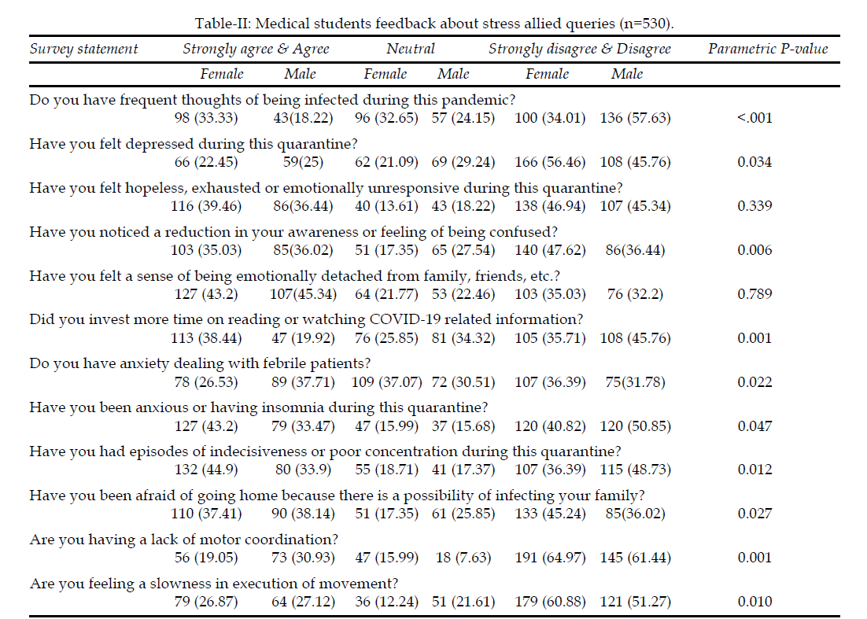
Literature Review - Mental Health and Well-Being
Meo et al. (2020)
Notes:
CLEO
12 stress allied responses were enquired from the medical students. 43.2% of female and 45.34%)male strongly agreed for a sense of being emotionally detached from family, fellow and friends.
While enquiring about depressed during this quarantine period 66 female and 59 male, about ¼ of the total number of participants felt depressed during the quarantine period.
While inquiring about feelings of hopeless exhausted or emotionally unresponsive during this quarantine period 116 female and 86 male agreed that they felt hopeless, exhausted, or em unresponsive during the quarantine period.

Slide 8
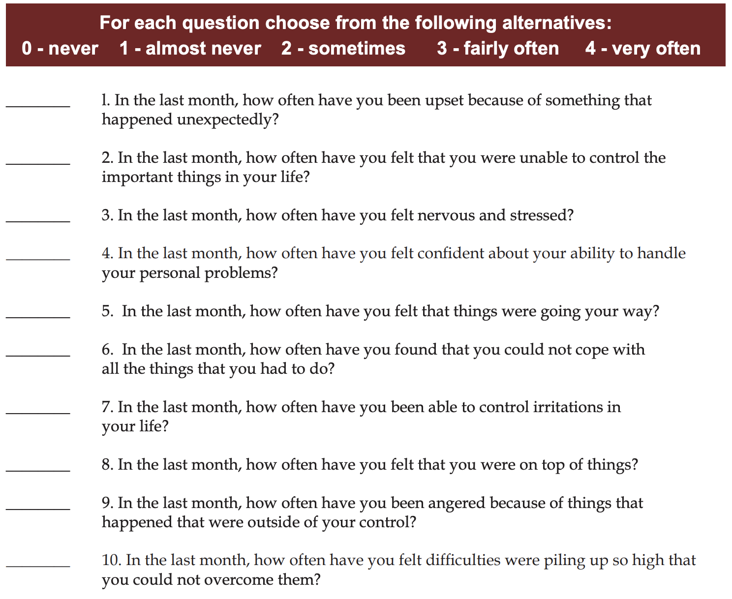
Data Collection
Undergraduate college students (18-22)
Self-reported questionnaires
Qualifying questions (undergrad and online)
Well-being
Perceived stress scale
Pandemic specific stressor questions
Academic Performance
Fall 2019 and Fall 2020 GPA
Demographic questions
Snowball sampling method
Cohen (1983)

Slide 9
Data Preparation
Perceived Stress Scale Score
Scores of questions 4, 5, 7, and 8 will be reversed
0 = 4, 1 = 3, 2 = 2, 3 = 1, 4 = 0
All 10 scores will be added up to get the total
Pandemic Specific Stressors
Adding the total score across 10 items
Student Performance (GPA)
Difference between Fall 2019 and Fall 2020 GPA

Slide 10

Analytical Methods
Descriptive statistics
Logistic Regression
Independent variables
Perceived stress
Pandemic specific stress
Dependent variable
GPA
Clustering
Silhouette plots to determine the optimal number of clusters
K-means clustering

Slide 11
Our Expectations
Confusion Matrix
Above 50% accuracy
Clustering
Optimal numbers of cluster to be 3
Medium - high Silhouette Score with high dense on effected group
Number of participants
> 100 participants
Student stress level - High
Pandemic & Personal Issues
P value in the regression
GPA
Average of 3.0/4.0

Slide 12

Limitations
Only use grade point average
Interaction with professors
Class attendances
Teacher to student ratio
Sampling Method
Subjective bias
Time

Slide 13
Implications
Due to the spread of the pandemic, both online learning shift and students’ well beings have direct effect on students’ performance in school
Further Analysis
Online learning support
Rehabilitation
Online advisor
Monitoring students
Develop an effective ways to monitor students remotely
Adjustment of online curriculum
More interaction among instructors and peers

Slide 14
References
Aguilera-Hermida, A. P. (2020). College students’ use and acceptance of emergency online
learning due to COVID-19. International Journal of Educational Research Open, 1, 100011.
Cohen, S., Kamarck, T., & Mermelstein, R. (1983). A global measure of perceived stress. Journal of Health and Social Behavior, 24(4), 385–396.
Leachman, M., Masterson, K., & Figueroa, E. (2017, November 29). A Punishing Decade for School Funding. Center on Budget and Policy Priorities. https://www.cbpp.org/research/state-budget-and-tax/a-punishing-decade-for-school-funding
Lederer, A. M., Hoban, M. T., Lipson, S. K., Zhou, S., & Eisenberg, D. (2021). More Than
Inconvenienced: The Unique Needs of U.S. College Students During the COVID-19 Pandemic. Health Education & Behavior, 48(1), 14-19. https://doi.org/10.1177/1090198120969372.
Meo, S. A., Abukhalaf, A. A., Alomar, A. A., Sattar, K., & Klonoff, D. C. (2020). COVID-19
pandemic: impact of quarantine on medical students’ mental wellbeing and learning behaviors. Pakistan Journal of Medical Sciences, 36(COVID19-S4), S43.
Morgan, Ivy. (2018). Funding Gaps 2018: An Analysis of School Funding Equity Across the U.S. and Within Each State. THE EDUC. TRUST. https://s3-us-east-2.amazonaws.com/edtrustmain/wpcontent/uploads/2014/09/20180601/Funding-Gaps-2018-Report-UPDATED.pdf.
Morona, A. (2020). Community college enrollment drops sharply: COVID-19 pandemic prompts
a 9.4% decrease at two-year institutions this fall. Crain’s Cleveland Business, 41(39), 1.a

